Slide 1
Pre-test questions
Where is Haiti located and what is/are the language/s spoken in Haiti?
Why did Holy Angels spend last year raising funds for Haiti?
What does the phrase “option for the poor and vulnerable” mean?

Slide 2
Prayer for Haiti
Our loving God,
as we embrace our partnership
with Beyond Borders in Haiti,
open our minds and hearts
to embrace our oneness
with our Haitian sisters and brothers
Open our eyes and ears to their urgent needs for
education, and freedom from poverty and slavery.

Slide 3
Open our hands that we might contribute
true partnership in Haiti; each one giving and
receiving with generosity and respect.
Jesus asks us to love one another as you, God,
love us all and give us the whole world to love!
Bless our offerings of time, talent and treasure.
Accept our desire for a loving, just and peaceful life
for Haitians and all people throughout the world.
Amen
Justine Nutz SSND

Slide 5
Meets

Slide 6
Partnership for mission is a way of being in relationship with others which enables the mutual exchange of learning, resources, wisdom, and values, so that the
interests, needs, and capacities
of others can be realized more fully.
Partnership is also a spiritual practice. It is indeed a journey in faith. It involves a willingness to explore a call, and trust that God-is-with-us.

Slide 7
Why???

Slide 9
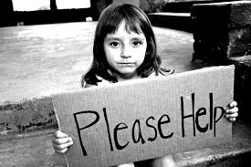
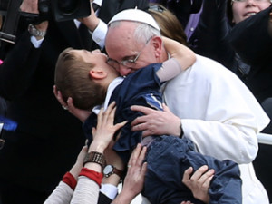
Option for the poor and vulnerable
Scripture teaches that God has a special concern for the poor and vulnerable. We are called to put the needs of the poor and vulnerable first. A measure of our society is how we care for and stand with our poor and vulnerable brothers and sisters.

Slide 10
Freda Catheus and Maureen Plaisimond from Beyond Borders at AHA in March 2017
Last year the AHA community rallied together to raise $5785
which was donated to Beyond Borders.

Slide 11
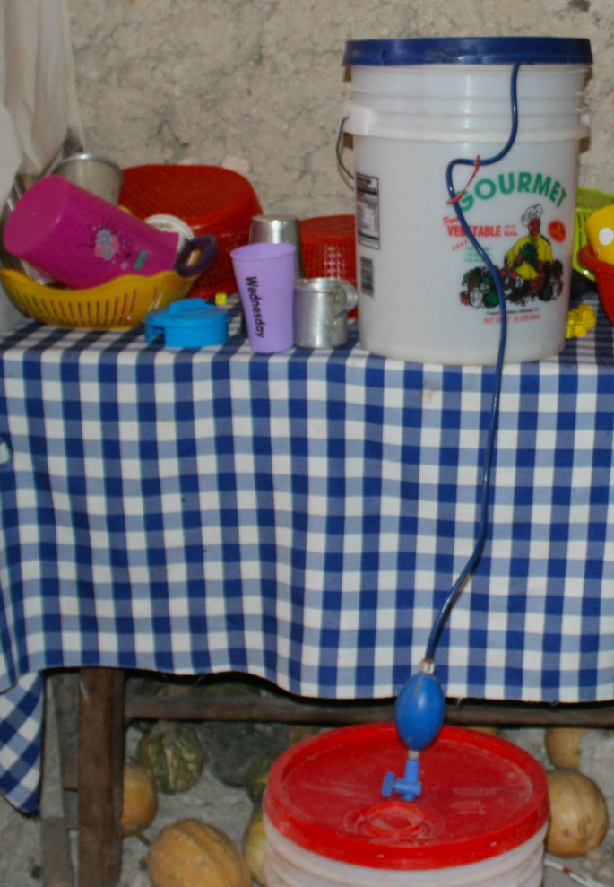
Hurricane Matthew (10/4/2016) devastated Haiti.
Holy Angels sponsored
three families…
The Cheler Family,
The Francois Family,
The Agnord Family
AHA's gift supports health education, access to healthcare, the construction of a sanitary latrine, and water purifiers like this (photo). These families are protected from cholera and other waterborne diseases.

Slide 12
Haiti is located in the Caribbean basin in the western one third of the island of Hispaniola. The eastern two-thirds of Hispaniola is the Dominican Republic.

Slide 13
About Haiti
Area: 10, 714 square miles (slightly smaller than Maryland)
Population: 10,485, 800 (July 2016)
Median Age: 22.6 years old
Language: Creole and French
Capital: Port- au-Prince
Unemployment: 40.6%
Haiti is the poorest country in the hemisphere. People there live on less than $1.25 a day.

Slide 14
Haiti
Tipalmis and
Nan Mango are the two communities where SSND will be collaborating with Beyond Borders.
Haiti
Lagonav Island
Haiti
Lagonav Island
Tipalmis
Nan Mango

Slide 15
About Laganov
The island of Laganov is located off the western coast of mainland Haiti.
Area: 37 miles long, 9 miles wide
Population: approx. 150,000
Language: Mostly Creole
Students from the Matenwa
Community Learning Center

Slide 16
Restavek is a
derogatory Creole
term meaning a child
who lives with
someone else.
It has been called a
“modern form of
slavery” by the
United Nations.

Slide 17
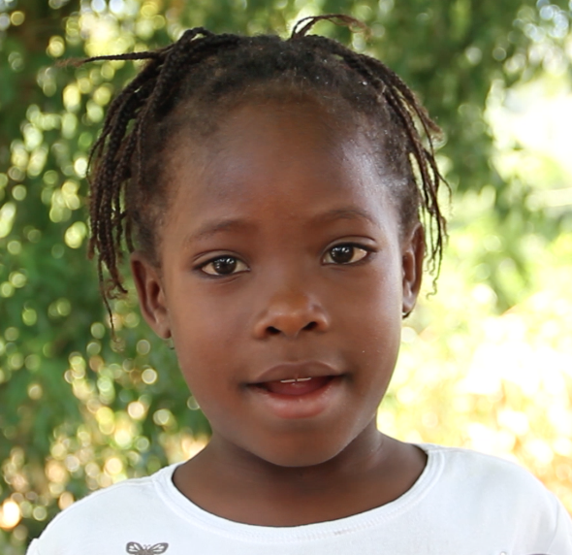
Why are Haitian children in slavery?
Haitian parents are no different from parents elsewhere. They love their children and want them to grow up at home. Still, each year tens of thousands of rural Haitian parents send their children away to live with families in distant cities. They do so in the hope that their children will be sent to school. In reality, many end up in homes where they are subjected to exploitation, abuse, neglect and denial of basic rights like going to school.
Marie-Love is home today thanks to the
efforts like those of SSND & Beyond Borders

Slide 18
The Vision of Schools Not Slavery:
Ensure every child goes to a high-quality school
Protect every child from slavery and abuse;
Ensure sustainable livelihoods for even the poorest
Prevent violence against every woman and girl

Slide 19
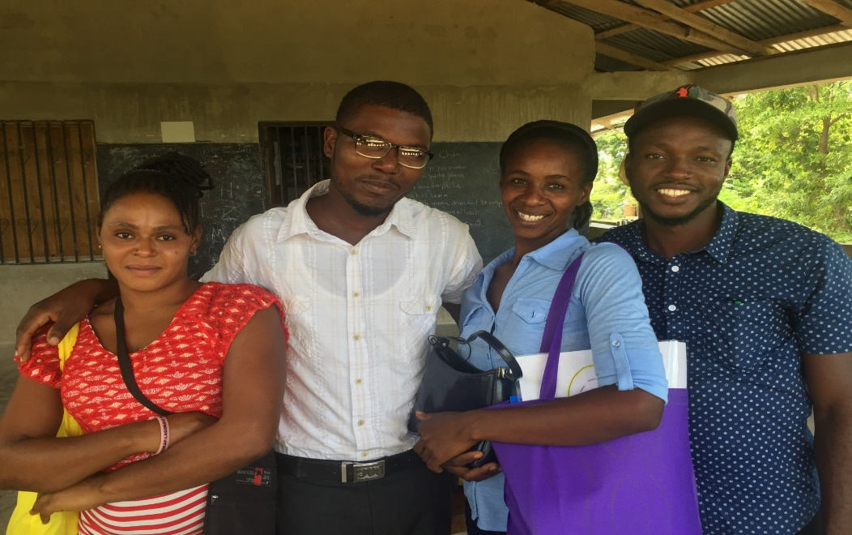
SSND Partnership with Beyond Borders
S. Sharon Slear SSND, (right) Chair of AHA’s Board of Trustees, teaching the teachers
Teachers in training from Lagonov
The SSND contingent visits Lagonov

Slide 20
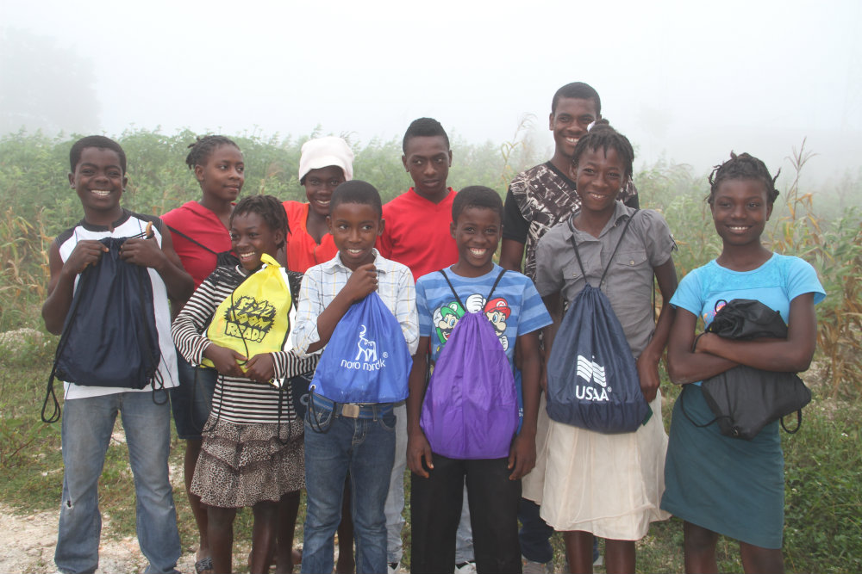
Children from the community of Nan Mango were among the 104 girls and boys freed from slavery, returned home, and enrolled in school in 2016.

Slide 21
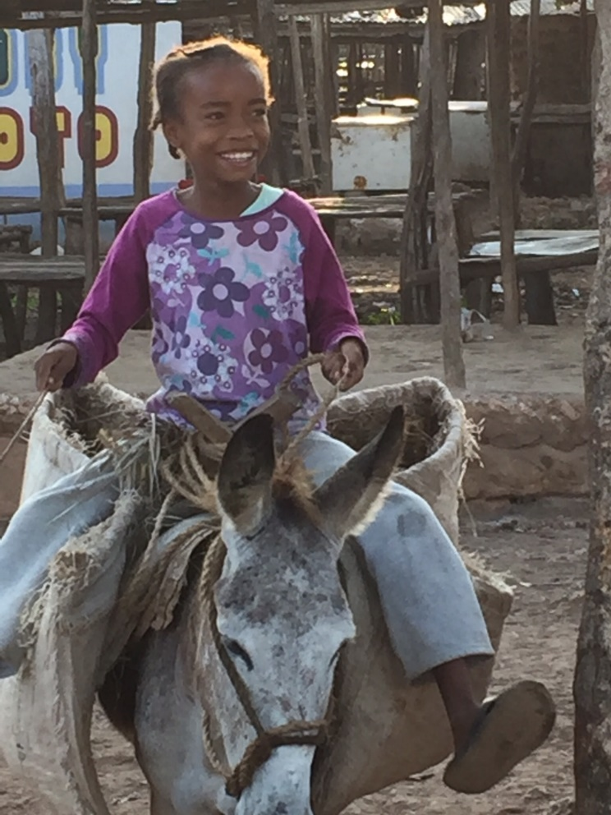
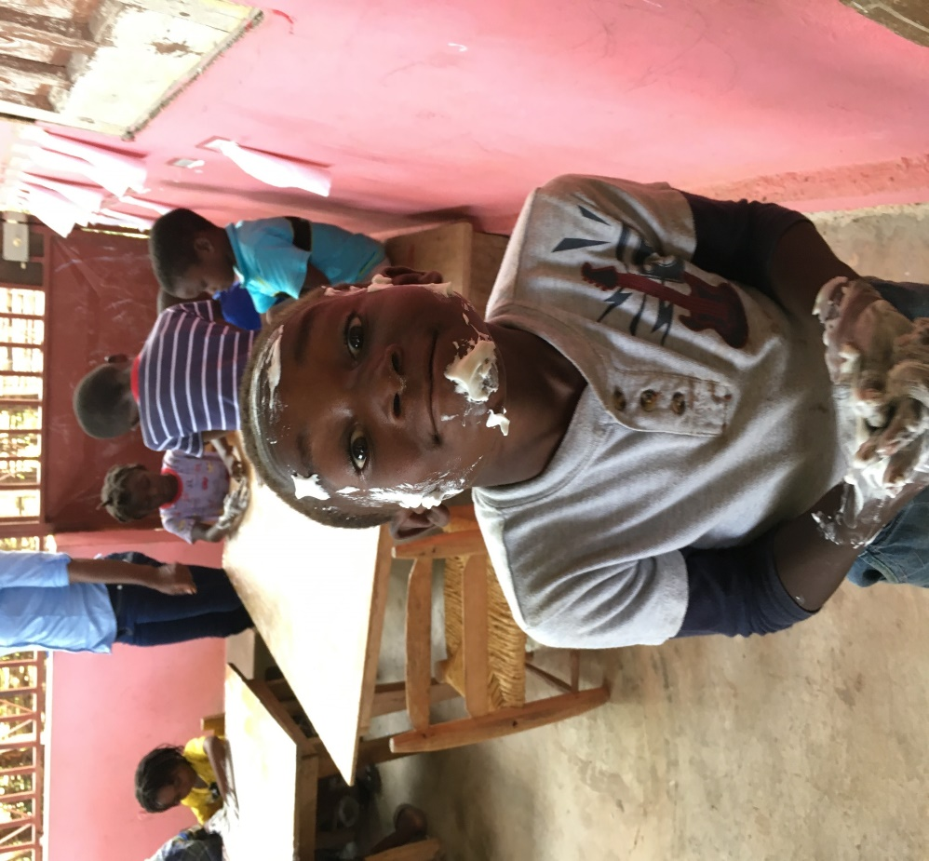

Slide 22
The Matenwa School Lagonav
Saint Lucie School
Lagonov

Slide 23
Small Group Discussion Questions
What are some factors that contribute to the problem of child slavery in Haiti?
List three benefits of learning in your native language.
Why should we at Holy Angels be concerned about child slavery in Haiti? What can we do to help eliminate this practice?

Slide 24
Information in this PowerPoint was gathered from:
https://beyondborders.net
SSNDschoolsnotslaverypartnership.org

